Slide 1


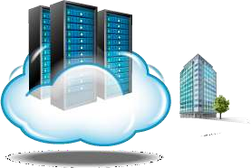
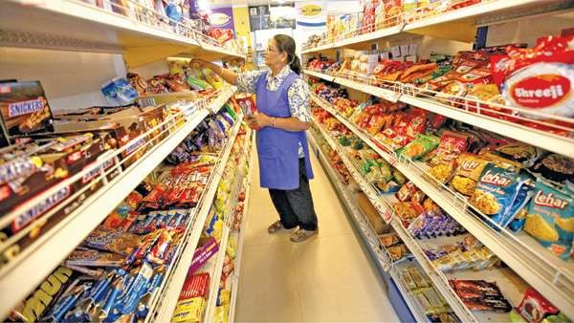
Resource Provisioning
1

Slide 2

Resource Provisioning
Cloud creates illusion of pool of resources
An activity of Allocation of cloud provider’s resources to a customer
When a cloud provider accepts Client’s request,
it must create number of VMs and allocate resources to support them
It takes Service Level Agreement (SLA) into
consideration for providing service to the cloud users
Dr.S.Sundararajan

Slide 3
Resource Provisioning
Resource provisioning means the
Selection
deployment, and
run-time management of S/W & H/W resources for ensuring guaranteed performance for
applications
Resource provisioning phases
Reservation phase – reserve resources
Expending phase - utilize resources
On-demand phase–provision of more resources
Dr.S.Sundararajan

Slide 4



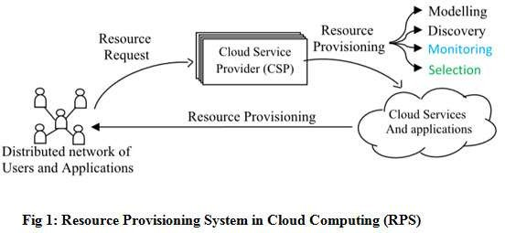
Resource Provisioning System
Resource Provisioning System
Resource Provisioning
DrS.Sundararajan

Slide 5



Resource Provisioning - Strategies
Strategies
Based on the Application, it may be
Static Provisioning –unchanging demands
Dynamic Provisioning - demands may change or vary
Self Provisioning – customer purchase computing resource from provider

Slide 6
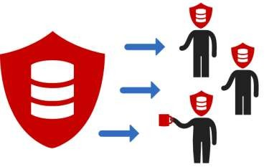
Parameter for Resource Provisioning
Resource provisioning techniques are used to improve the following QoS parameters
Response time
Minimizing cost
Maximizing Revenue
Fault tolerant
Reduced SLA violation
Reduced power consumption
Parameter for Resource Provisioning
Dr.S.Sundararajan

Slide 7


Resource Provisioning Methods
Over provisioning of resources will lead to resource underutilization, and revenue loss for provider
Under provisioning of resources will lead to broken SLAs and penalties
Deploying an autonomous system is a challenging, because difficulty comes from
unpredictability of consumer demand
Uncertainty in prices
software and hardware failures
heterogeneity of services
power management
conflicts in signed SLAs between consumers and service providers
Dr.S.Sundararajan

Slide 8
Resource Provisioning Methods
Demand driven
Add/remove instances based on current utilization level of the allocated resources
when a resource has surpassed a threshold for a certain amount of time, the scheme increases that resource based on demand.
When a resource is below a threshold for a certain amount of time
Dr.S.Sundararajan

Slide 9
Resource Provisioning Methods
Resource Provisioning Methods
Event driven
Add/remove time event
instances based on specific
Anticipates peak traffic before it happens
Popularity driven
Internet searches create popularity demand
scheme anticipates increased traffic with popularity
Dr.S.Sundararajan

Slide 10

Dynamic Resource Deployment
Dynamic Resource Deployment
To achieve scalability in performance
InterGrid-managed infrastructure
was
developed by a Melbourne University
A Java- software allows to create execution cloud environments on top of all participating grid resources
Intergrid gateway (IGG) allocates resources from a local cluster to deploy applications in three steps:
Requesting the VMs
enacting the VMs
deploying the VMs as requested
Dr.S.Sundararajan
10

Slide 11
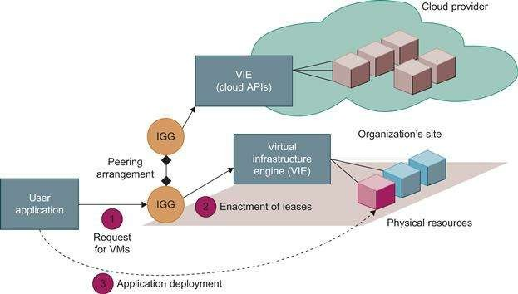
Dynamic Resource Deployment
Dr.S.Sundararajan
11

Slide 12
Dynamic Resource Deployment
IGG interacts with another IGG that can allocate
resources from provider under peak demand
A grid has predefined peering arrangements with other grids, which the IGG manages.
Through multiple IGGs, the system coordinates the use of InterGrid resources.
An IGG is aware of the peering terms with other grids, selects suitable grids that can provide the required resources, and replies to requests from other IGGs
Dr.S.Sundararajan
12

Slide 13
Dynamic Resource Deployment
InterGrid allocates and provides a distributed virtual environment (DVE). This is a virtual cluster of VMs that runs isolated from other virtual clusters.
DVE manager component performs resource allocation and management on behalf of specific user applications
Scheduler, core component for implementing provisioning policies and peering with other gateways
communication component provides an asynchronous
message-passing mechanism.
Received messages are handled in parallel by a thread pool
13

Slide 14
Dynamic Resource Deployment
Distributed file system for storing large-scale data
Another form of data storage is (Key, Value) pairs
GFS (Google File System): implemented to meet rapidly growing demands of Google’s data processing needs
HDFS(Hadoop Distributed File System): implemented for the purpose of running MapReduce applications
Amazon S3 and EBS: S3 used to store/retrieve data from remote servers whereas EBS built on top of S3 for using virtual disks in running EC2 instances
Traditional database system
Provisioning for structured and semi structured data management
14

Slide 15

Storage Resource Provisioning
Data storage layer is built on top of the physical or
virtual servers
A distributed file system is ideal for storing large- scale data
Databases are built with stored data files or in the form of (Key, Value) pairs,
Examples are
GFS: Google FileSystem
HDFS: Hadoop Distributed File System
Amazon S3 and EBS
15

Slide 16
Storage Resource Provisioning
Cloud databases stores data in structural or semi-
structural ways.
BigTable from Google
SimpleDB from Amazon
SQL service from Microsoft Azure
Scaling of such a database might be quite large for processing huge amounts of data
16

Slide 17

Dynamic Resource Deployment

